Slide 1
Music genre classifier
Artur Díaz, Maria Espina & Jordi Vaccher
DRCAV

Slide 2



General schematic
Train system
Test system
Features Extraction

Slide 3
GTZAN dataset
This dataset was used for the well known paper in genre classification "Musical genre classification of audio signals" by G. Tzanetakis and P. Cook in IEEE Transactions on Audio and Speech Processing 2002.
Blues
Classical
Country
Disco
Hip-Hop
Jazz
Metal
Pop
Reggae
Rock

Slide 4
System schematic
Feature extraction
Classifier
Genre label
Blues
Classical
Country
Disco
Hip-Hop
Jazz
Metal
Pop
Reggae
Rock
Zero Crossing Rate
Spectral Centroid
Spectral Rolloff
Chroma Frequencies
Mel-Frequency Cepstral Coefficients
Mel spectrogram
Neural network
SVM
Gaussian Naïve Bayes
Tree decissor
Random forest

Slide 5

Feature extraction
Zero Crossing Rate
Spectral Centroid
Spectral Rolloff
Chroma Frequencies
Mel-Frequency Cepstral Coefficients
Mel spectrogram

Slide 6


Classification
Neural network
SVM
Gaussian Naïve Bayes classifier
Tree decissor
Random forest classifier

Slide 7
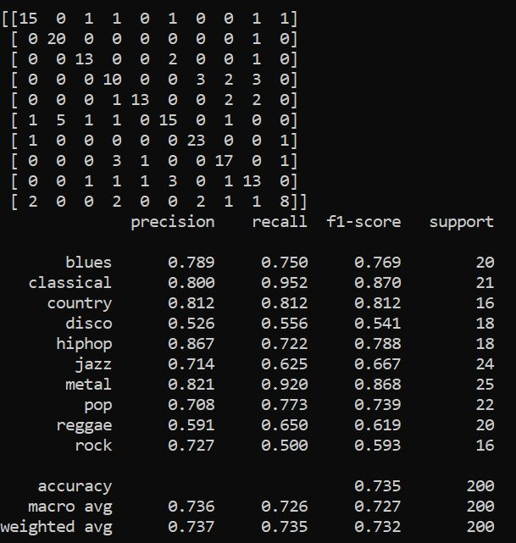
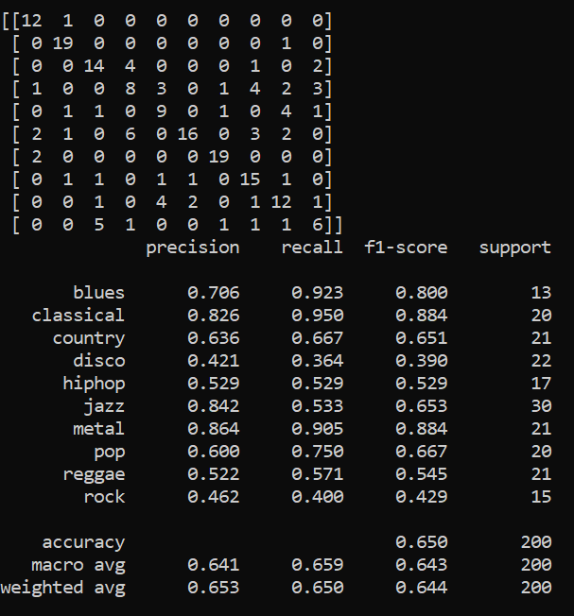
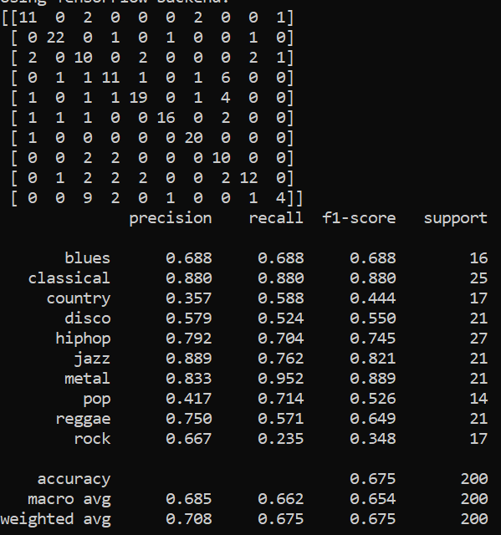
Results
Neural network Support vector machine Random forest

Slide 8
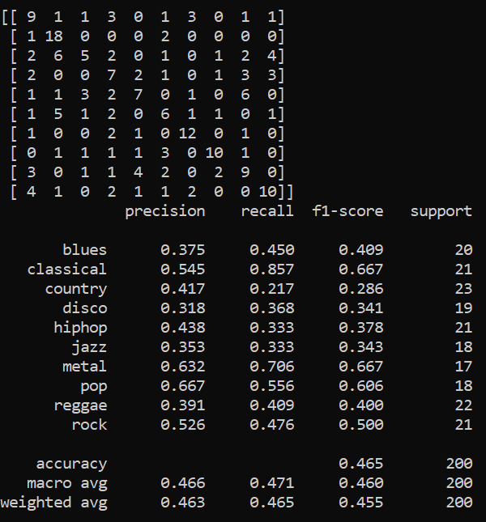
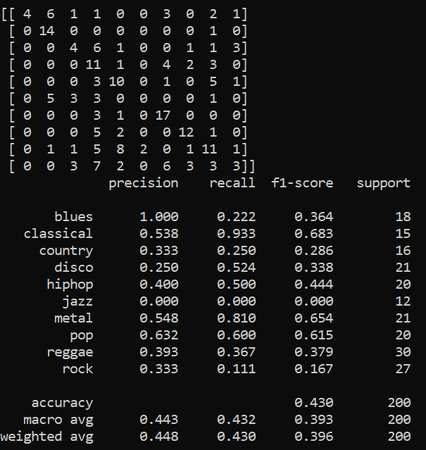
Results
Gaussian Naïve Bayes classifier Decision tree classifier

Slide 9
Song recommender
From a selected song:
Zero Crossing Rate
Spectral Centroid
Spectral Rolloff
Chroma Frequencies
Mel-Frequency Cepstral Coefficients
Mel spectogram
Neural Network
Name of the most similar song

Slide 10

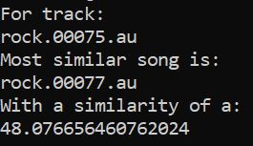
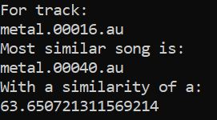
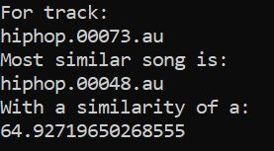
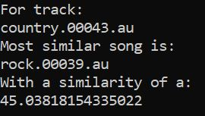
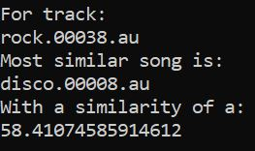
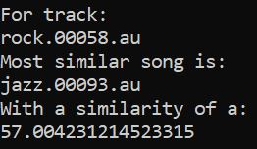
Results
Hiphop.00073
Hiphop.00048
Rock.00038
Disco.00008
Using the previous neural network.

Slide 11
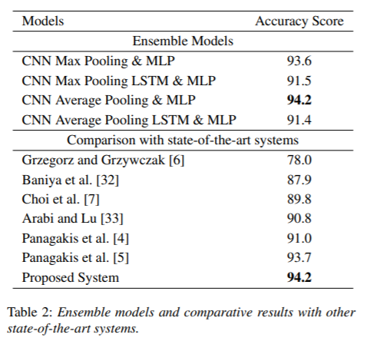
Conclusions
Results improved comparing to the initial system of Music Genre Classification with Python.
Still far from Music Genre Recognition using Deep Neural Networks and Transfer Learning system.
Reasonable recommended song system.
Genre is a subjective classification.

Slide 12
Bibliography
Music Genre Classification with Python.
Parul Pandey.
https://towardsdatascience.com/music-genre-classification-with-python-c714d032f0d8
Music Genre Recognition using Deep Neural Networks and Transfer Learning.
Deepanway Ghosal, Maheshkumar H. Kolekar.
Indian Institute of Technology Patna, India.
https://www.isca-speech.org/archive/Interspeech_2018/pdfs/2045.pdf

